Slide 1


OTP GENERATION PROJECT
Loknath B Panada

Slide 2
INTRODUCTION
A race towards Digitalization.
Processing and Managing large scale data.
Critical Role of Security in Transactions
Approaches to Safeguard Transactions.
OTP and security

Slide 3
OBJECTIVE
Implement a function to generate a secured 6-digit OTP randomly.
Develop a function to simulate sending the OTP to the user's email address.
Create a function to prompt the user to enter the OTP received in their email.
Implement a function to verify the OTP entered by the recipient user.
Ensure proper error handling and user-friendly prompts.
Allow the user to retry OTP entry 3 times in case of incorrect input.

Slide 4
PYTHON MODULES
import secrets – To generate cryptographically strong random OTP.
import string – To create only digits.
import smtplib - To send OTP from an email client to email server.
import re - To match an Email pattern.
import time - To set time frame of 90 seconds to enter otp.
import tkinter as tk - To create graphical user interface.
from tkinter import messagebox - To display simple pop-up message boxes.

Slide 5
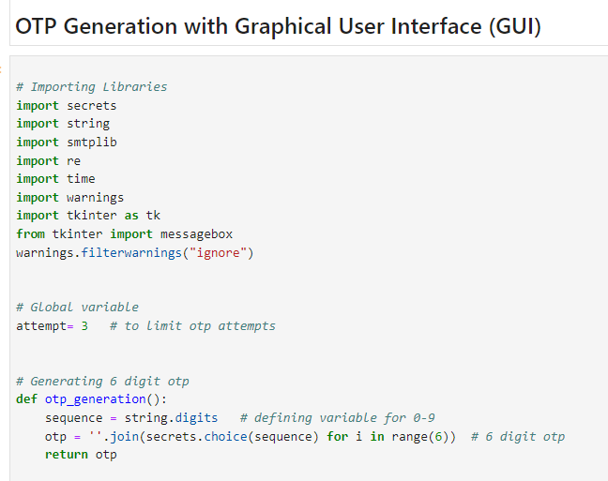
Importing various python modules
Defining global variable “attempt” to limit OTP inputs for wrong entries
Function to create cryptographically secured OTP

Slide 6
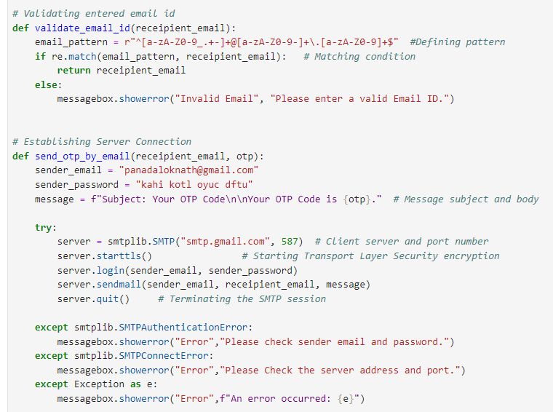
Validating Email Id with format of xxxx@xx.xx
Establishing secure connection to SMTP server through port 587 and sending otp to recipient email id

Slide 7
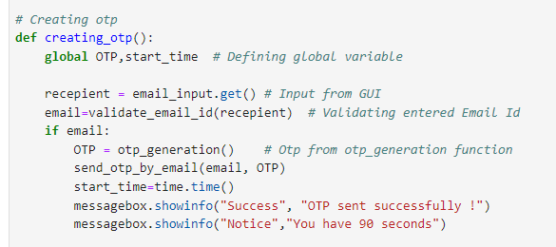
Creating OTP when the sent otp button is invoked and starting the time frame of 90 second

Slide 8
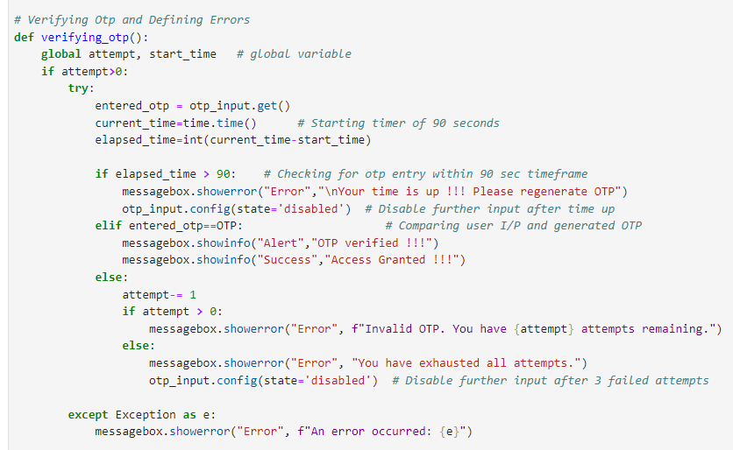
Verifying OTP and creating user interaction by pop up messages for time up error, OTP match success, OTP mismatch error and attempts exhaustion error

Slide 9
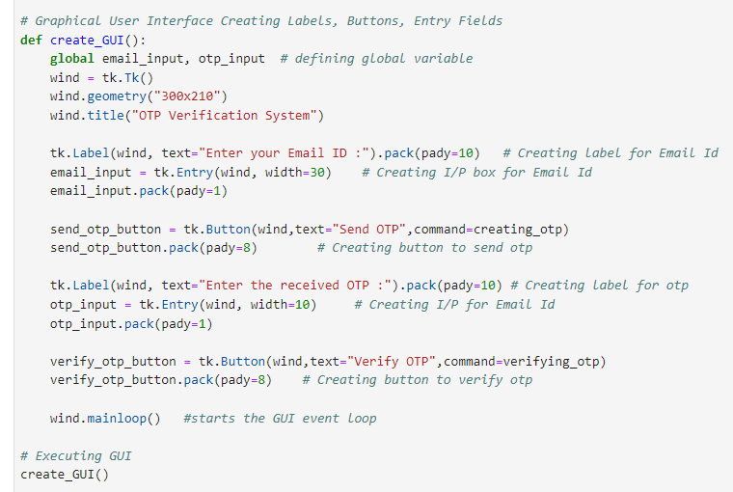
Creating window of GUI with pixel size of 300x210 creating label for email Id input and otp verification , input box for entering Email Id and received otp and lastly defining functions within their respective buttons

Slide 10
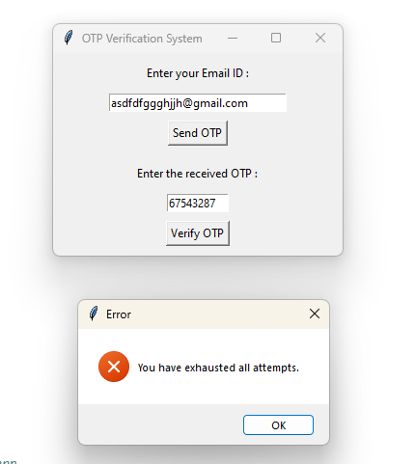
Pop up message after entering wrong OTP 3 times

Slide 11
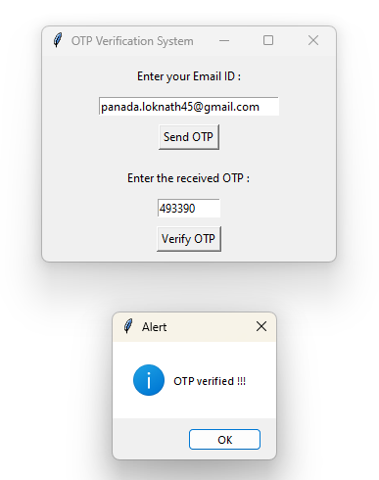
Pop up message after entering the right OTP

Slide 12
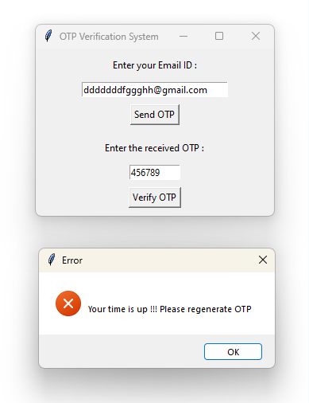
Pop up message after OTP is expired and session is timed out

Slide 13
FUNCTIONS
otp_generation()
string.digits
‘’”.join
secrets.choice(sequence)
range(6)
re.match(email_pattern, receipient_email)
Return
messagebox.showerror
smtplib.SMTP("smtp.gmail.com", 587)
server.starttls
server.login(sender_email, sender_password)
server.sendmail(sender_email, receipient_email, message)
server.quit()
email_input.get()
messagebox.showinfo()
global attempt, start_time

Slide 14
FUNCTIONS
def function_name(a,b)
string.digits
‘’”.join()
secrets.choice(sequence)
range(n)
re.match(pattern, string)
Return
global var_name
time.time()
windows.mainloop()
tk.Tk()
window.title("title_name")
window.geometry("wxh")
SMTP.starttls()
tk.Label(wind, text="label_name")
window.title("title_name")
tk.Entry(parent_window, option)
otp_input.config(state='disabled’)
.get()
messagebox.showinfo()
messagebox.showerror(title, message)
tk.Button(parent, text="Button Text", command=callback_function)
smtplib.SMTP(host='', port=0, local_hostname=None, [timeout, ]source_address=None)
SMTP.login(user, password, *, initial_response_ok=True)
SMTP.sendmail(from_addr, to_addrs, msg, mail_options=(), rcpt_options=())
SMTP.quit()

Slide 15
FUNCTIONS
time.time()
otp_input.config(state='disabled’)
tk.Tk()
wind.geometry("300x210")
wind.title("OTP Verification System")
tk.Label(wind, text="Enter your Email ID :")
tk.Entry(wind, width=30)
email_input.pack(pady=1)
tk.Button(wind,text="Send OTP",command=creating_otp)
wind.mainloop()

Slide 16
CONCLUSION
Secrets module has been used to generate cryptographically secured otp.
SMTPLIB modules has been used to connect with GMAIL client server and the connection has been secured through Transport Layer Security using smtp.starttls() function.
Graphical User Interface has been created to enhance the user experience.
The program presents :-
i. The successful attempt as “Access Granted”
ii. The wrongly entered otp as “Access Denied”
iii. The 3 unsuccessful attempts as “You Have Exhausted All Attempts” and
iv. The delay in entering otp above 90 sec as “Your Time is Up ! Please Regenerate
OTP !!!”

